Slide 1
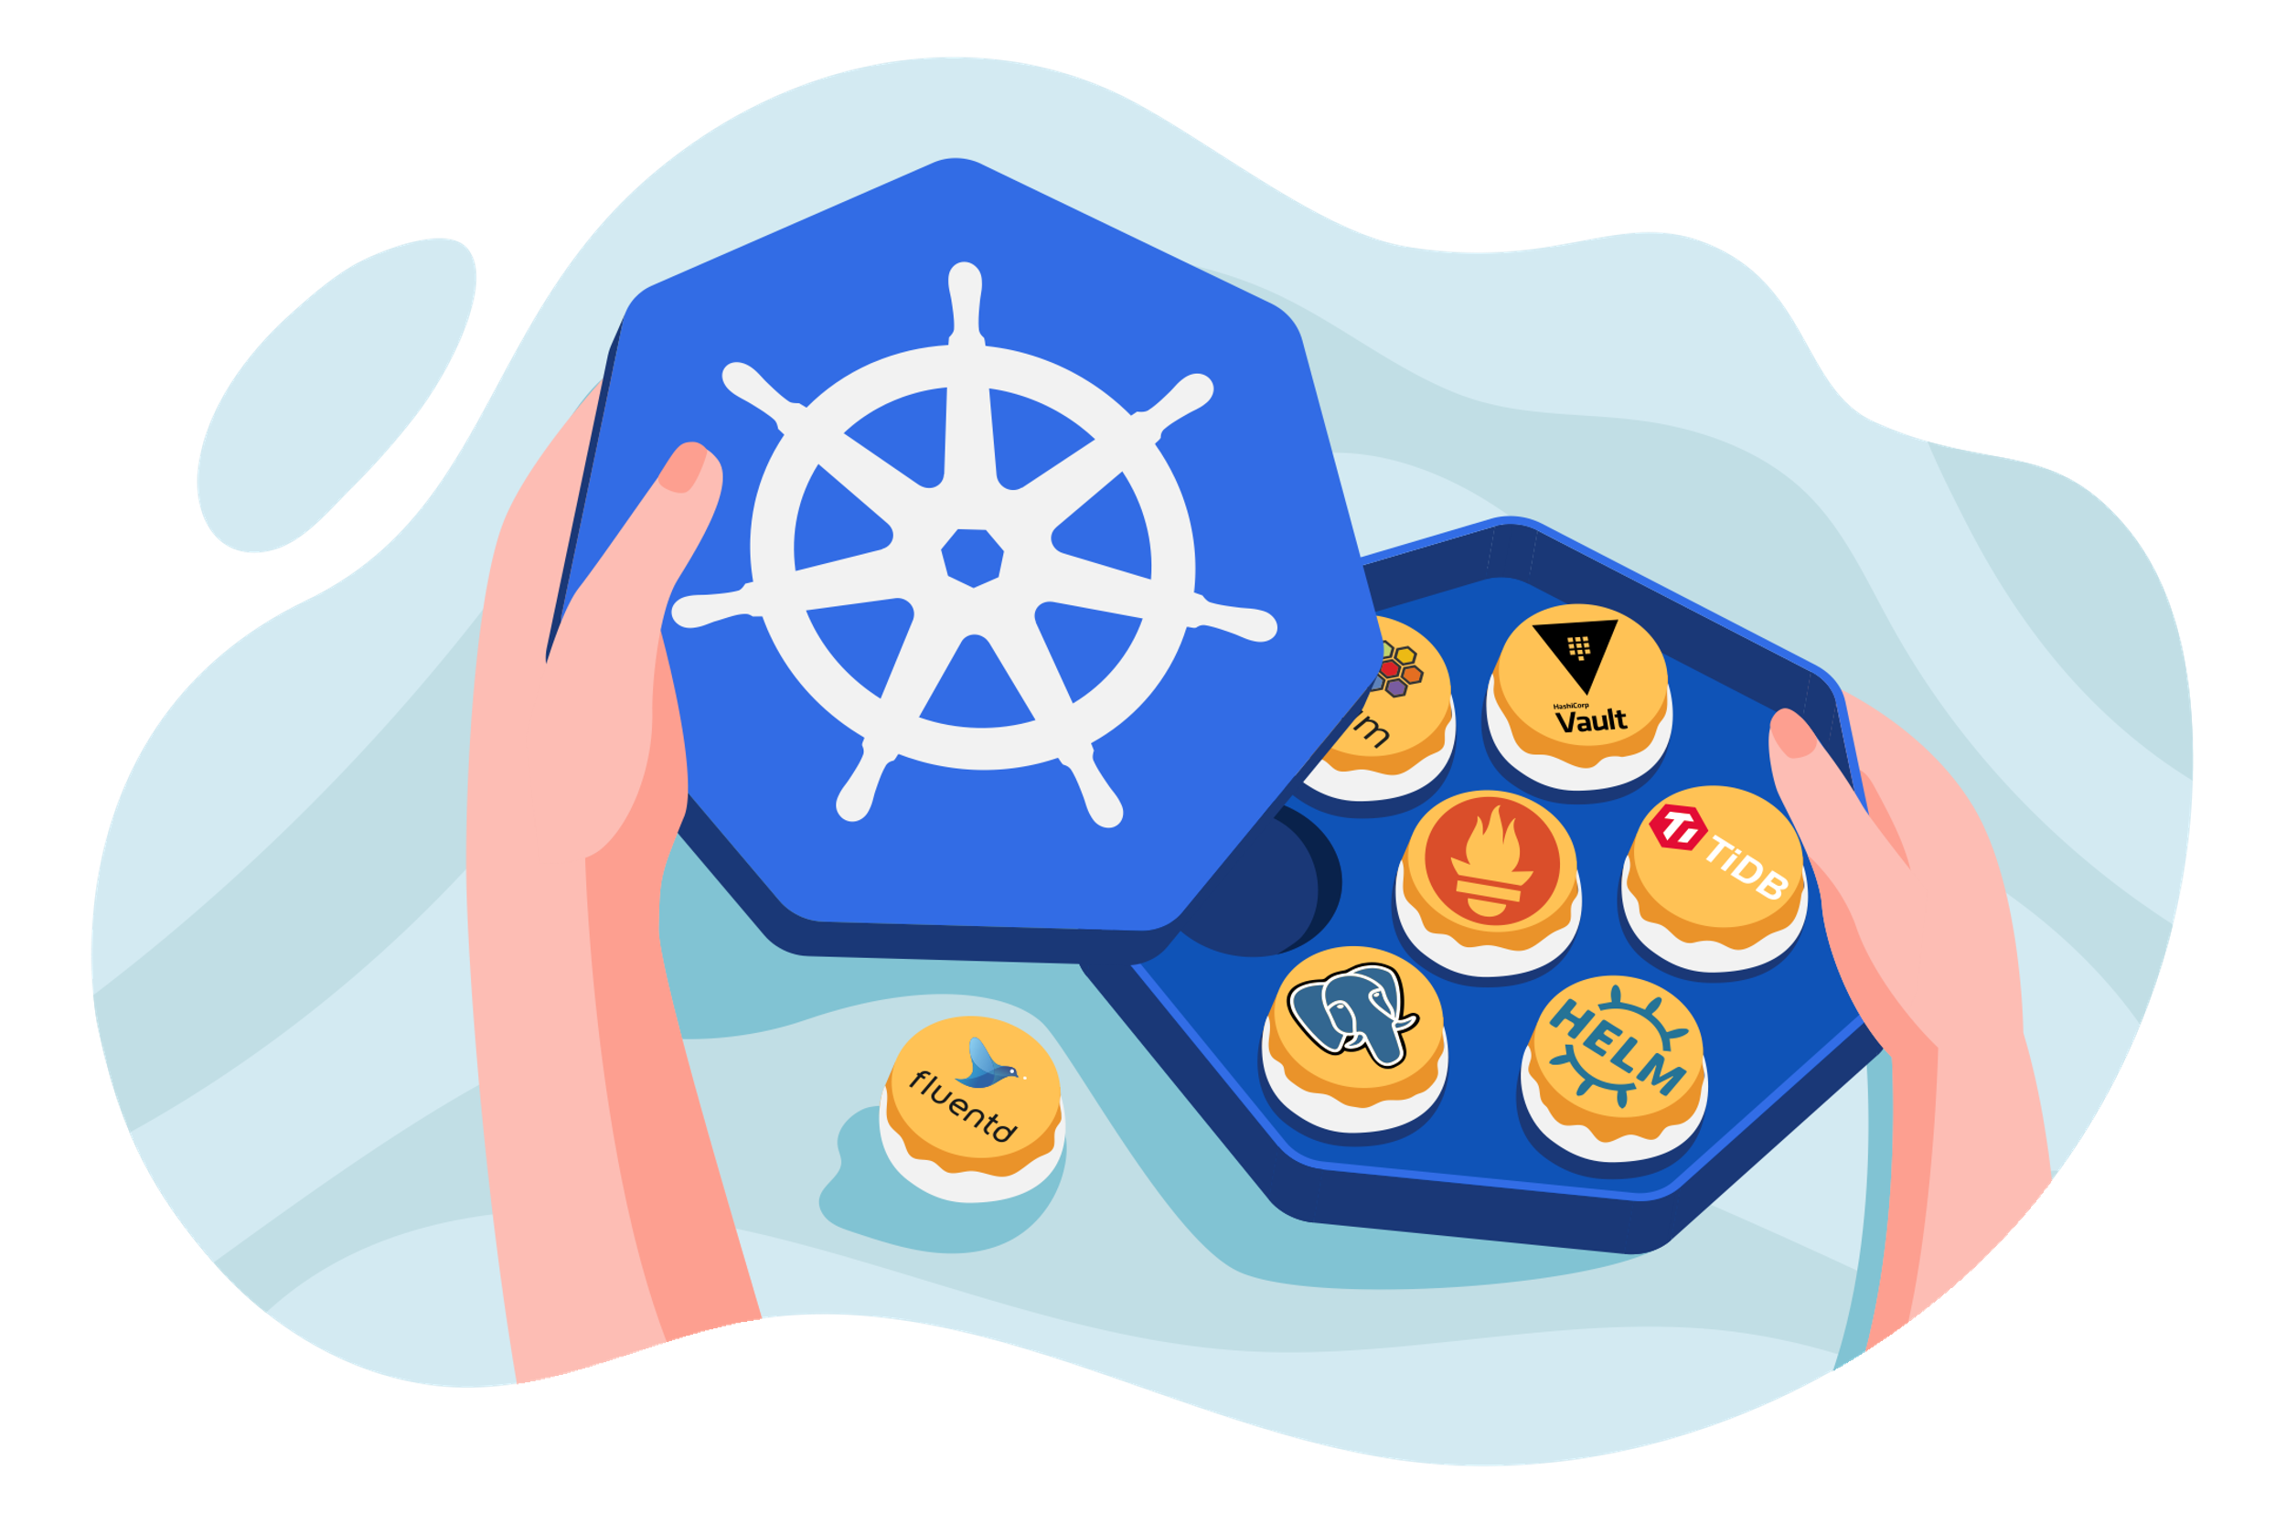
Pod Autoscaling in Kubernetes Clusters
Angelina Horn
Source: https://learnk8s.io/autoscaling-apps-kubernetes

Slide 2
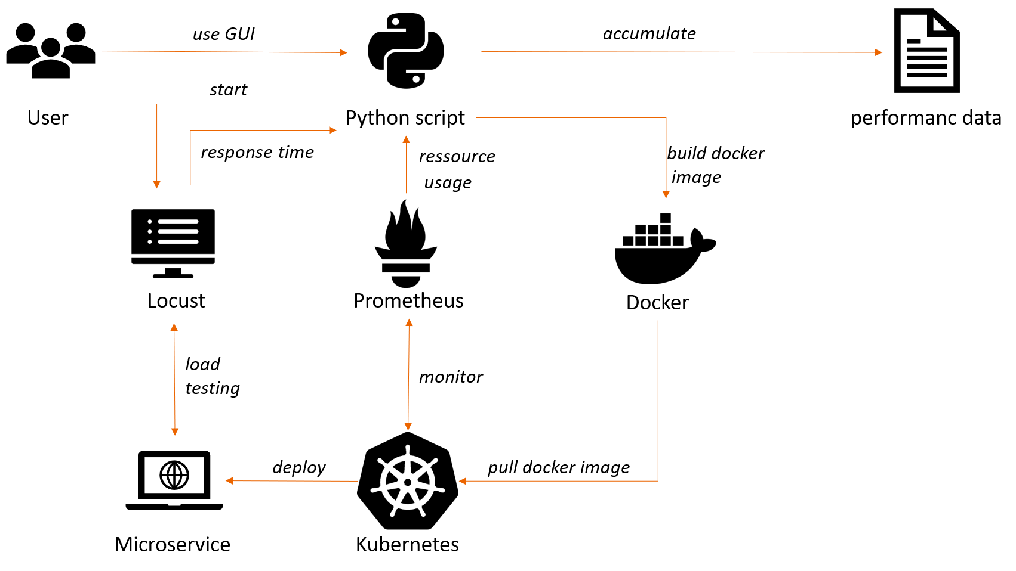
Sandbox

Slide 3
Content
1
Motivation
4
2
Basics
6
3
State of the Art
11
4
Approach
17
5
Application Area
23

Slide 4
Content
1
Motivation
4
2
Basics
6
3
State of the Art
11
4
Approach
17
5
Application Area
23

Slide 5

Motivation
Microservice architecture (splitting of applications) is gaining popularity
Dynamic load on certain parts of the application
Dynamic scale of resources
Maintain performance
No wastage of resources
Newer technology
Alshuqayran et al. (2016)
Source: https://learnk8s.io/blog/scaling-spring-boot-microservices
Notes:
Microservices:
Applications get splittet into independet parts which can communicate over APIs
Hosted in the cloud
Mostly not maintained by the developer therefore are resswources costly

Slide 6
Content
1
Motivation
4
2
Basics
6
2.1
Kubernetes
7
2.2
Autoscaling
9
3
State of the Art
11
4
Possible Approaches
17
5
Application Area
23

Slide 7
Content
1
Motivation
4
2
Basics
6
2.1
Kubernetes
7
2.2
Autoscaling
9
3
State of the Art
11
4
Possible Approaches
17
5
Application Area
23

Slide 8

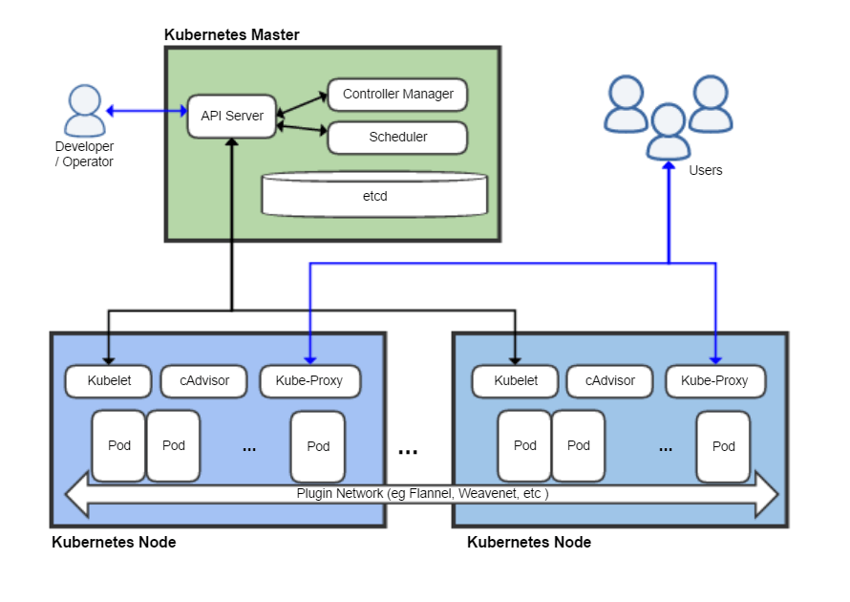
Kubernetes (K8s)
Open source orchestral tool for containerized applications
Originally developed by Google (2014)
→ Donated to Cloud Native Computing Foundation (CNCF)
Functionality:
Automatic deployment
Scaling
Organization
Source: https://de.wikipedia.org/wiki/Kubernetes

Slide 9
Content
1
Motivation
4
2
Basics
6
2.1
Kubernetes
7
2.2
Autoscaling
9
3
State of the Art
11
4
Possible Approaches
17
5
Application Area
23

Slide 10

Autoscaling
Automatic scaling of pods in relation to certain metrics
Several approaches possible:
Threshold bound vs. flexible
Mathematical programming vs. heuristics
Horizontal
Vertical
Deploy more/fewer instances of a certain pod
Increase/decrease resources (e.g. CPU share) of existing pod
vs.

Slide 11
Content
1
Motivation
4
2
Basics
6
3
State of the Art
11
3.1
Horizontal and Vertical Scaling using Reinforcement Learning
12
3.2
Performance Analysis of Vertical Scaling
15
4
Approach
17
5
Application Area
23

Slide 12
Content
1
Motivation
4
2
Basics
6
3
State of the Art
11
3.1
Horizontal and Vertical Scaling using Reinforcement Learning
12
3.2
Performance Analysis of Vertical Scaling
15
4
Approach
17
5
Application Area
23

Slide 13
Horizontal and Vertical Scaling of Container-based Applications using Reinforcement Learning
Idea: use model-based reinforcement learning (rf) to reduce learning phase
Implemented capabilities in Docker Swarm with Elastic Docker Sawm (EDS)
5-action vs. 9-action model
Compared to Q-learning and Dyna-Q reinforcement approaches
Replaced unknown transition probabilities and unknown cost function with empirical estimates
Monitor Analyze Plan Execute control loop
Rossi et al. (2019)

Slide 14


Horizontal and Vertical Scaling of Container-based Applications using Reinforcement Learning
Q-learning
Model-based RF
Often changes application deployment
Exceeds $R_{max}$ more often (30%)
Deploys fewer big containers with more CPU usage (Ø 1.7 containers with 89% of CPU)
Stable application deployment
More than halves $R_{max}$ exceed (12%)
Deploys more medium containers with lower CPU usage (Ø 5.11 container with 47% CPU)
Rossi et al. (2019)
Notes:
Question:
How long did they learn? Only 360 minutes?
Would Q-learning have made equal or better choices when it had more time to learn?

Slide 15
Content
1
Motivation
4
2
Basics
6
3
State of the Art
11
3.1
Horizontal and Vertical Scaling using Reinforcement Learning
12
3.2
Performance Analysis of Vertical Scaling
15
4
Approach
17
5
Application Area
23

Slide 16
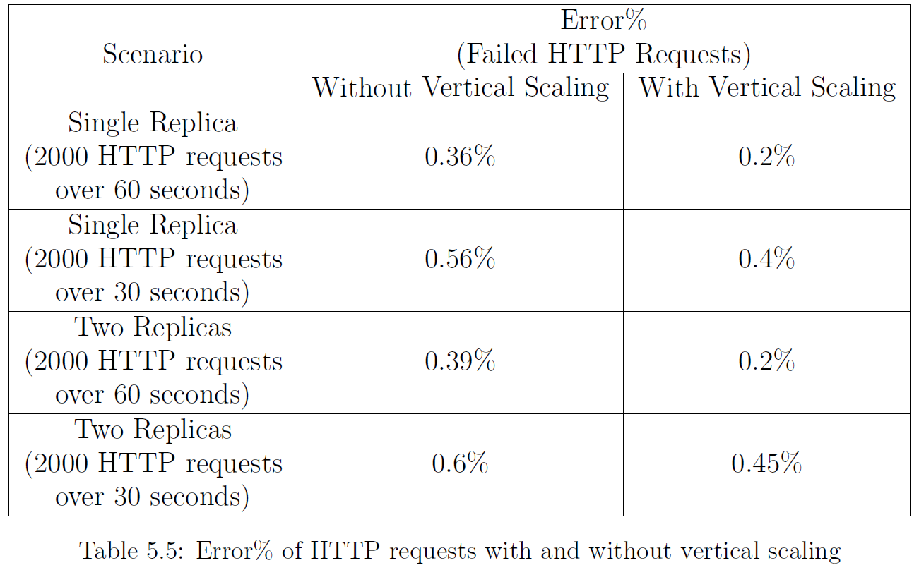
Performance Analysis of the Impact of Vertical Scaling on Application Containerized with Docker
Analysis
Results
Objective: evaluate the impact of vertical scaling on performance
Kubernetes on Amazon Web Services
Manual scaling via “Rolling Update”
“Apache JMeter” for web server testing
Metrics: latency & responds time
Two scenarios with two different loads
No significant impact on latency and responds time
No downtime because of Kubernetes
Midigudla, D. (2019)
Notes:
Question:
What was the CPU usage? Did it reach 100% when not scaled?

Slide 17
Content
1
Motivation
4
2
Basics
6
3
State of the Art
11
4
Approach
17
5
Application Area
23

Slide 18
Overview
GUI
Machine Learning
Control Script
Kubernetes Cluster
Configures load pattern and
Machine learning environment
Predicts performance model:
How and when?
Observes & scales microservices
according to performance model
Executes commands from
control script

Slide 19
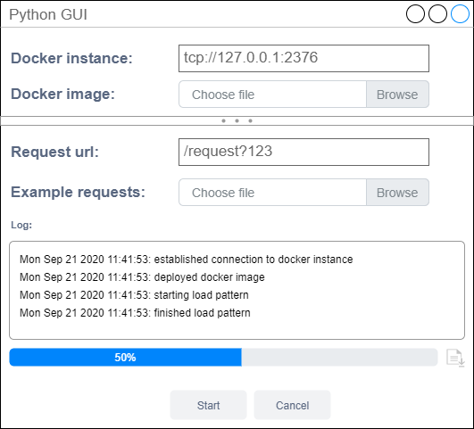
GUI
Only interaction point for the user
Configuration for performance data
Process overview via logging

Slide 20
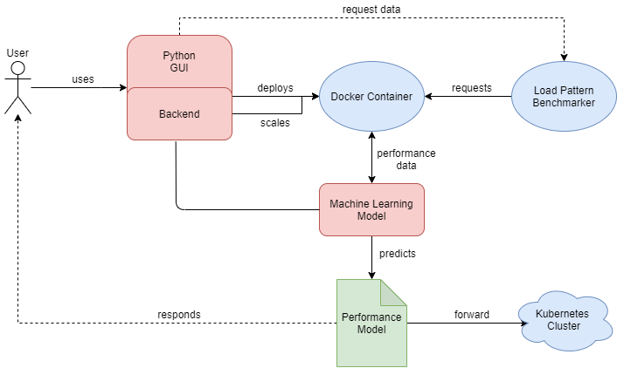
Machine Learning Overview
Uses load pattern generator
Python Script scales automatically
→ Automatic process

Slide 21
Machine Learning
Restricted to applications using queues and files as input
Predicts not only the scaling strategy but also how much to scale
Possible learners: bagging, boosting, and deep neural networks [5]
Features [6]:
Request rate (per minute)
Response time (in seconds)
Utilization of resources (CPU & RAM Usage in percent)
Output:
Predictive performance model
Scaling strategy: vertical or/and horizontal
Unused resources
Request size (in mb)

Slide 22




Control Script
Performance Model
interacts
Control Script
1.
2.
3.
Scaling commands
Performance data
Input information

Slide 23
Content
1
Motivation
4
2
Basics
6
3
State of the Art
11
4
Approach
17
5
Application Area
23

Slide 24
Application Area
Software AG
OctoScan
Company:
Established in 1969 in Darmstadt
Around 5.000 employees worldwide
Enterprise software service provider
Department:
Technical Alliances & Compliance (TCA)
E.g. Export Control, Licensing etc.
Web application: Python & HTML/JavaScript
Scans source code for different information (e.g. copyrights, licenses or cryptography content)
uses different scan engines (e.g. ScanCode toolkit, Crypto Detector)
Currently deployed as Docker container on different servers
Can profit from scaling

Slide 25

Questions?
Thank you!

Slide 26
Sources
[1] | Rossi, F., Nardelli, M., & Cardellini, V. (2019, July). Horizontal and vertical scaling of container-based applications using reinforcement learning. In 2019 IEEE 12th International Conference on Cloud Computing (CLOUD) (pp. 329-338). IEEE.
[2] | Midigudla, D. (2019). Performance Analysis of the Impact of Vertical Scaling on Application Containerized with Docker: Kubernetes on Amazon Web Services-EC2.
[3] | kubernetes.io visited on 7/7/2020
[4] | learnk8s.io visited on 7/7/2020
[5] | Malakar, P., Balaprakash, P., Vishwanath, V., Morozov, V., & Kumaran, K. (2018, November). Benchmarking machine learning methods for performance modeling of scientific applications. In 2018 IEEE/ACM Performance Modeling, Benchmarking and Simulation of High Performance Computer Systems (PMBS) (pp. 33-44). IEEE.
[6] | Qu, C., Calheiros, R. N., & Buyya, R. (2018). Auto-scaling web applications in clouds: A taxonomy and survey. ACM Computing Surveys (CSUR), 51(4), 1-33.

